Slide 1
CST205 OOP –STRINGS IN JAVA –MODULE 4

Slide 2
OBJECTIVES
To understand the significance of String class in java.
To illustrate methods of String class.
To explore StringBuffer class,a peer class of String.
To compare the StringBuffer class and String class.

Slide 3
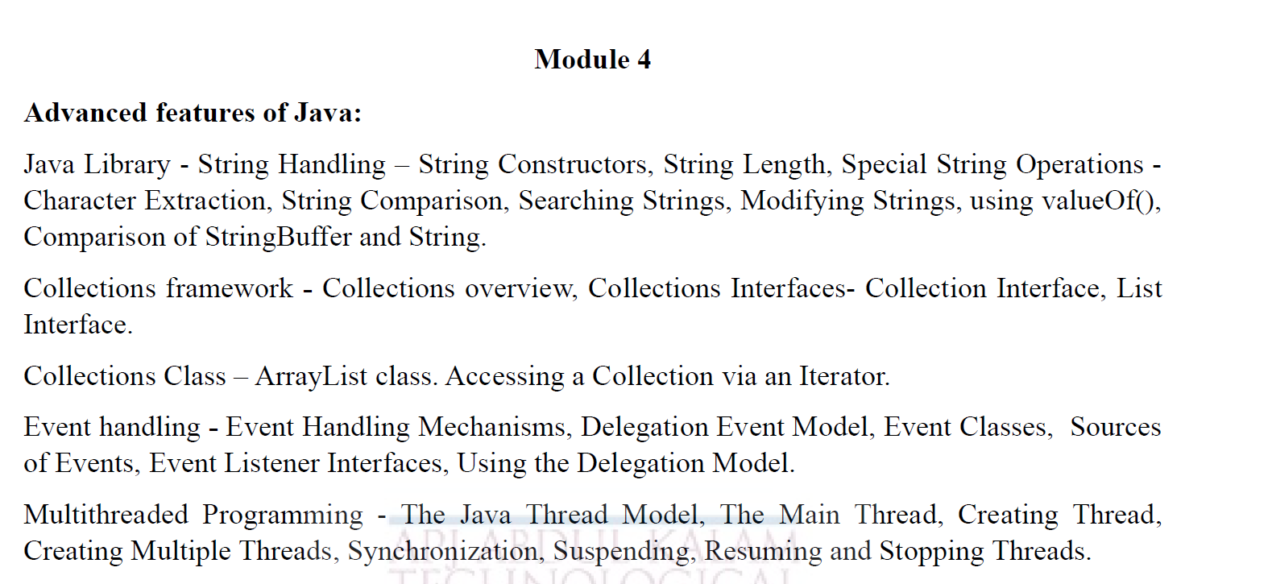
syllabus

Slide 4
syllabus
CO2 | Develop Java application programs using java constructs, operators, control statements, built in packages, input /output streams, files and libraries and advanced features of java

Slide 5
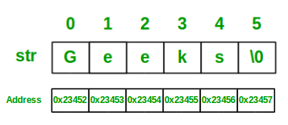
STRINGS IN JAVA
Strings are used for storing text.
A String variable contains a collection of characters surrounded by double quotes.
Strings in Java are Objects that are backed internally by a char array.
Syntax:
<String_Type> <string_variable> = “<sequence_of_string>”;
Example : String str = "Geeks";

Slide 6
STRINGS IN JAVA
The first thing to understand about strings is that every string you create is actually an object of type String.
Even string constants are actually String objects. For example, in the statement
System.out.println("This is a String, too");
the string “This is a String, too” is a String constant.
The second thing to understand about strings is that objects of type String are immutable;
once a String object is created, its contents cannot be altered.
Each time you need an altered version of an existing string, a new String object is created that contains the modifications.
The original string is left unchanged.
This approach is used because fixed, immutable strings can be implemented more efficiently than changeable ones.
For those cases in which a modifiable string is desired, Java provides two options: StringBuffer
and StringBuilder. Both hold strings that can be modified after they are created.

Slide 7
The String
String is a sequence of characters, for e.g. “Hello” is a string of 5 characters.
In java, string is an immutable object which means it is constant and cannot be changed once it has been created.
Creating a String
1.String literal
Eg: String s = “GeeksforGeeks”;
2.Using new keyword
Eg: String s = new String (“GeeksforGeeks”);

Slide 8
STRINGS IN JAVA
The String, StringBuffer, and StringBuilder classes are defined in java.lang. Thus, they are available to all programs automatically.
The String Constructors
To create an empty String, you call the default constructor. For example,
String s = new String(“HELLO”);
will create an instance of String with no characters in it.
To create a String initialized by an array of characters, use the constructor shown here:
String(char chars[ ])
Here is an example:
char chars[] = { 'a', 'b', 'c' };
String s = new String(chars);
This constructor initializes s with the string “abc”.

Slide 9
The String Constructors
You can specify a subrange of a character array as an initializer using the following constructor:
String(char chars[ ], int startIndex, int numChars)
Here, startIndex specifies the index at which the subrange begins, and numChars specifies the number of characters to use.
Here is an example:
char chars[] = { 'a', 'b', 'c', 'd', 'e', 'f' };
String s = new String(chars, 2, 3);
This initializes s with the characters cde.
You can construct a String object that contains the same character sequence as another String object using this constructor:
String(String strObj)

Slide 10
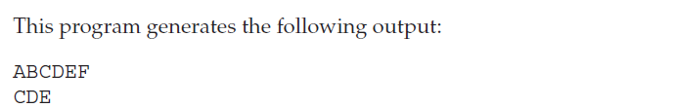
The String Constructors
The String class provides constructors that initialize a string when given a byte array.
String(byte asciiChars[ ])
String(byte asciiChars[ ], int startIndex, int numChars)
Here, asciiChars specifies the array of bytes. The second form allows you to specify a subrange.
In each of these constructors, the byte-to-character conversion is done by using the default character encoding of the platform.
// Construct string from subset of char array.
class SubStringCons {
public static void main(String args[])
{
byte ascii[] = {65, 66, 67, 68, 69, 70 };
String s1 = new String(ascii);
System.out.println(s1);
String s2 = new String(ascii, 2, 3);
System.out.println(s2);
}}

Slide 11
The String Constructors
// Construct one String from another.
class MakeString {
public static void main(String args[]) {
char c[] = {'J', 'a', 'v', 'a'};
String s1 = new String(c);
String s2 = new String(s1);
System.out.println(s1);
System.out.println(s2);
}
}
The output from this program is as follows:
Java
Java

Slide 12
Immutable String in Java
In java, string objects are immutable.
Immutable simply means unmodifiable or unchangeable.
Once string object is created its data or state can't be changed but a new string object is created.
class Testimmutablestring{
public static void main(String args[]){
String s="Sachin";
s.concat(" Tendulkar");//concat() method appends the string at the end
System.out.println(s);//will print Sachin because strings are immutable objects
}
}
Output: Sachin

Slide 13
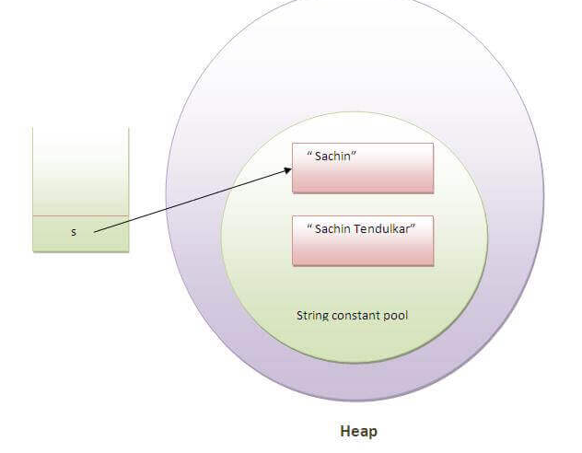

Slide 14
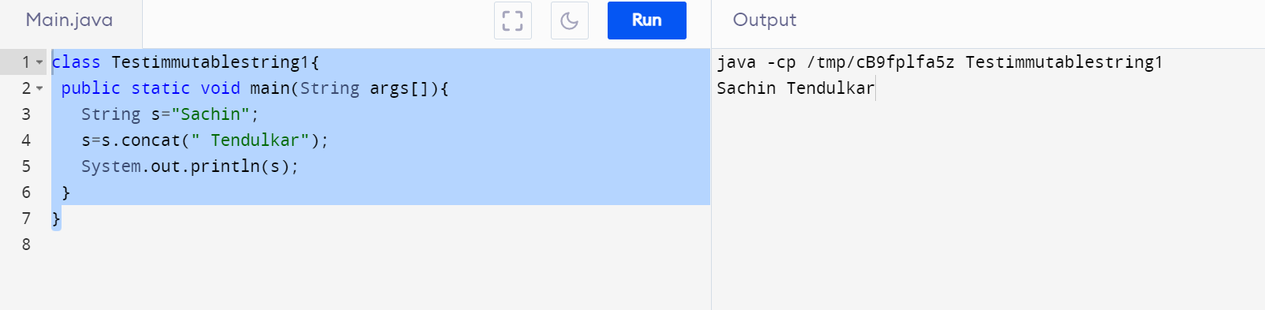
class Testimmutablestring1{
public static void main(String args[]){
String s="Sachin";
s=s.concat(" Tendulkar");
System.out.println(s);
}
}

Slide 15
Why String objects are immutable in Java?
As Java uses the concept of String literal. Suppose there are 5 reference variables, all refer to one object "Sachin".
If one reference variable changes the value of the object, it will be affected by all the reference variables.
That is why String objects are immutable in Java.

Slide 16
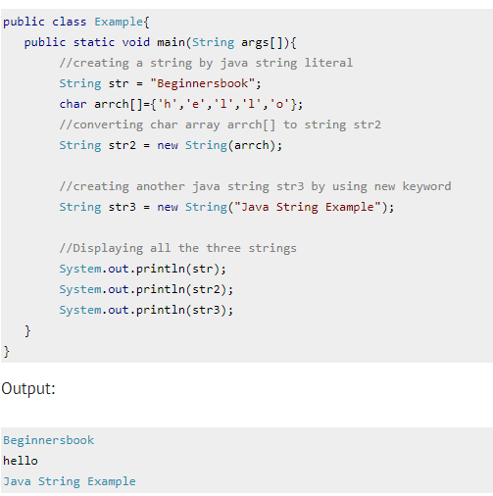

Slide 17
String Operations
STRING LENGTH
The length of a string is the number of characters that it contains. To obtain this value, call the
length( ) method, shown here: int length( )
Eg: System.out.println(“Hello”.length());
public class StringDemo
{
public static void main(String args[])
{
String palindrome = "Dot saw I was Tod";
int len = palindrome.length();
System.out.println("String Length " + len);
} }
Output
String Length is : 17

Slide 18
Special String Operations
String Literals
char chars[] = { 'a', 'b', 'c' };
String s1 = new String(chars);
String s2 = "abc"; // use string literal
System.out.println("abc".length());
Or
char chars[] = { 'a', 'b', 'c' };
String s1 = new String(chars);
String s2 = "abc"; // use string literal
System.out.println(s1.length());

Slide 19

Special String Operations
String Concatenation
string1.concat(string2);
The + operator is used to concatenate two or more strings.
Eg: String myname = “Harry”
String str = “My name is” + myname + “.”;

Slide 20
Special String Operations String Concatenation
String age = "9";
String s = "He is " + age + " years old.";
System.out.println(s);
This displays the string “He is 9 years old.”
String Concatenation with Other Data Types
int age = 9;
String s = "He is " + age + " years old.";
System.out.println(s);
This is because the int value in age is automatically converted into its string representation within a String object. This string is then concatenated as before.
The compiler will convert an operand to its string equivalent whenever the other operand of the + is an
instance of String.

Slide 21
Special String Operations -String Concatenation
String s = "four: " + 2 + 2;
System.out.println(s);
This fragment displays four: 22 rather than the four: 4
Operator precedence causes the concatenation of “four” with the string equivalent of 2 to take place first. This result is then concatenated with the string equivalent of 2 a second time.
To complete the integer addition first, you must use parentheses, like this:
String s = "four: " + (2 + 2);
Now s contains the string “four: 4”.

Slide 22
Special String Operations -String Conversion and toString( )
The toString( ) method has this general form:
String toString( )
To implement toString( ), simply return a String object that contains the human-readable string that appropriately describes an object of your class.
// Override toString() for Box class.
class Box {
double width;
double height;
double depth;
Box(double w, double h, double d) {
width = w;
height = h;
depth = d;
}

Slide 23
Special String Operations -String Conversion and toString( )
public String toString() {
return "Dimensions are " + width + " by " +
depth + " by " + height + ".";
}}
class toStringDemo {
public static void main(String args[]) {
Box b = new Box(10, 12, 14);
String s = "Box b: " + b; // concatenate Box object
System.out.println(b); // convert Box to string
System.out.println(s);
}
}

Slide 24
Special String Operations -String Conversion and toString( )
The output of this program is shown here:
Dimensions are 10.0 by 14.0 by 12.0
Box b: Dimensions are 10.0 by 14.0 by 12.0
As you can see, Box’s toString( ) method is automatically invoked when a Box object is used in a concatenation expression or in a call to println( ).

Slide 25
String Operations: Character Extraction
1. charAt(int index)
Characters in a string can be extracted in a number of ways.
Like arrays, the string indexes begin at zero.
char charAt(int index)
Returns the character at the specified index. An index ranges from 0 to length() - 1.
The first character of the sequence is at index 0, the next at index 1, and so on, as for array indexing.
char ch;
ch = “abc”.charAt(1); // ch = “b”

Slide 26
String Operations: Character Extraction
2.getChars()
If you need to extract more than one character at a time, you can use the getChars( ) method
getChars() - Copies characters from this string into the destination character array.
public void getChars(int srcBegin, int srcEnd, char[] dst, int dstBegin)
srcBegin - index of the first character in the string to copy.
srcEnd - index after the last character in the string to copy.
dst - the destination array.
dstBegin - the start offset in the destination array.
Return: It does not return any value.
Exception: StringIndexOutOfBoundsException – If srcBegin , srcEnd are not in proper range.

Slide 27
String Operations: Character Extraction
class getCharsDemo {
public static void main(String args[]) {
String s = "This is a demo of the getChars method.";
int start = 10;
int end = 14;
char buf[] = new char[10];
s.getChars(start, end, buf, 0);
System.out.println(buf);
}
}
Here is the output of this program:
demo

Slide 28
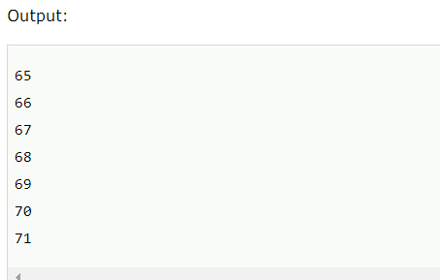
String Operations: Character Extraction
3.getBytes( )
There is an alternative to getChars( ) that stores the characters in an array of bytes.
The java string getBytes() method returns the byte array of the string.
Here is its simplest form: byte[ ] getBytes( )
public class StringGetBytesExample{
public static void main(String args[]){
String s1="ABCDEFG";
byte[] barr=s1.getBytes();
for(int i=0;i<barr.length;i++){
System.out.println(barr[i]);
}
}}

Slide 29
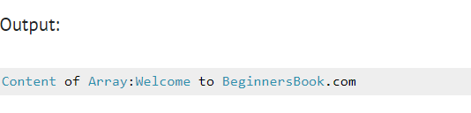
String Operations: Character Extraction
4. toCharArray( )
If you want to convert all the characters in a String object into a character array, the easiest way is to call toCharArray( ).
It returns an array of characters for the entire string. It has this general form:
char[ ] toCharArray( )
public class CharArrayExample{
public static void main(String args[]){
String str = new String("Welcome to BeginnersBook.com");
char[] array= str.toCharArray();
System.out.print("Content of Array:");
for(char c: array){
System.out.print(c); }
} }

Slide 30
String Comparison
equals( ) and equalsIgnoreCase( )
Compares the invoking string to the specified object.
The result is true if and only if the argument is not null and is a String object that represents the same sequence of characters as the invoking object.
The comparison is case-sensitive.
boolean equals(Object anObject)
To perform a comparison that ignores case differences, call equalsIgnoreCase( ).
When it compares two strings, it considers A-Z to be the same as a-z.
It has this general form:
boolean equalsIgnoreCase(String str)

Slide 31
String Comparison
// Demonstrate equals() and equalsIgnoreCase().
class equalsDemo {
public static void main(String args[]) {
String s1 = "Hello";
String s2 = "Hello";
String s3 = "Good-bye";
String s4 = "HELLO";
System.out.println(s1 + " equals " + s2 + " -> " + s1.equals(s2));
System.out.println(s1 + " equals " + s3 + " -> " + s1.equals(s3));
System.out.println(s1 + " equals " + s4 + " -> " + s1.equals(s4));
System.out.println(s1 + " equalsIgnoreCase " + s4 + " -> " +
s1.equalsIgnoreCase(s4));
}
}

Slide 32
String Comparison
// Demonstrate equals() and equalsIgnoreCase().
The output from the program is shown here:
Hello equals Hello -> true
Hello equals Good-bye -> false
Hello equals HELLO -> false
Hello equalsIgnoreCase HELLO -> true

Slide 33
String Comparison
regionMatches( )
The regionMatches( ) method compares a specific region inside a string with another specific region in another string.
There is an overloaded form that allows you to ignore case in such comparisons.
Here are the general forms for these two methods:
boolean regionMatches(int startIndex, String str2,int str2StartIndex, int numChars)
boolean regionMatches(boolean ignoreCase, int startIndex, String str2,int str2StartIndex, int numChars)
For both versions, startIndex specifies the index at which the region begins within the invoking String object. The String being compared is specified by str2.
The index at which the comparison will start within str2 is specified by str2StartIndex. The length of the substring being compared is passed in numChars.

Slide 34

String Comparison
public class RegionMatchesExample{
public static void main(String args[]){
String str1 = new String("Hello, How are you");
String str2 = new String("How");
String str3 = new String("HOW");
System.out.print("Result of Test1: " );
System.out.println(str1.regionMatches(7, str2, 0, 3));
System.out.print("Result of Test2: " );
System.out.println(str1.regionMatches(7, str3, 0, 3));
System.out.print("Result of Test3: " );
System.out.println(str1.regionMatches(true, 7, str3, 0, 3));
}
}

Slide 35
startsWith( ) and endsWith( )
The startsWith( ) method determines whether a given String begins with a specified string.
Conversely, endsWith( ) determines whether the String in question ends with a specifiedstring.
They have the following general forms:
boolean startsWith(String str)
boolean endsWith(String str)
Here, str is the String being tested. If the string matches, true is returned. Otherwise, false is returned.
For example,
"Foobar".endsWith("bar") and "Foobar". startsWith("Foo") are both true.
A second form of startsWith( ), shown here, lets you specify a starting point:
boolean startsWith(String str, int startIndex) Here, startIndex specifies the index into the invoking string at which point the search will begin. For example,
"Foobar".startsWith("bar", 3) returns False.

Slide 36
Difference between == and .equals() method in Java
Main difference between .equals() method and == operator is that one is method and other is operator.
the equals( ) method compares the characters inside a String object.
The == operator compares two object references to see whether they refer to the same instance.
We can use == operators for reference comparison (address comparison) and .equals() method for content comparison.
In simple words, == checks if both objects point to the same memory location whereas .equals() evaluates to the comparison of values in the objects.

Slide 37
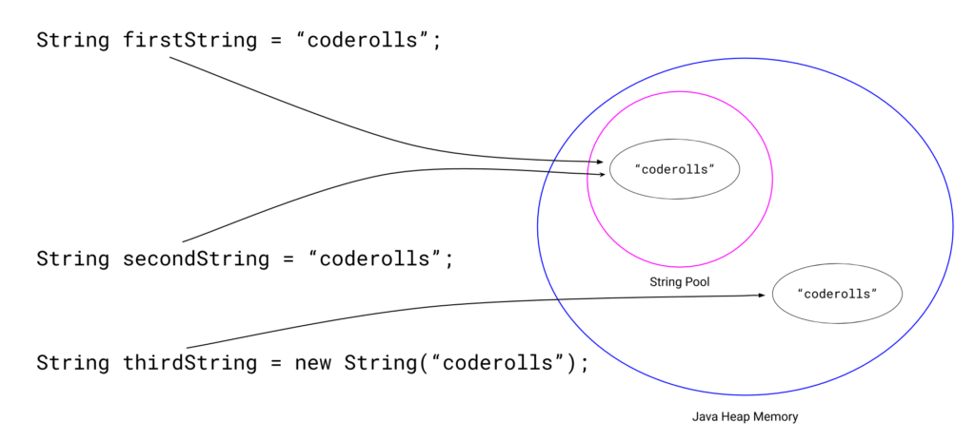
Difference between == and .equals() method in Java
public class Test {
public static void main(String[] args)
{
String firstString = "coderolls";
String secondString = "coderolls";
System.out.println(firstString == secondString);
String thirdString = new String("coderolls");
System.out.println(firstString == thirdString);
}
OUTPUT :
true
false

Slide 38
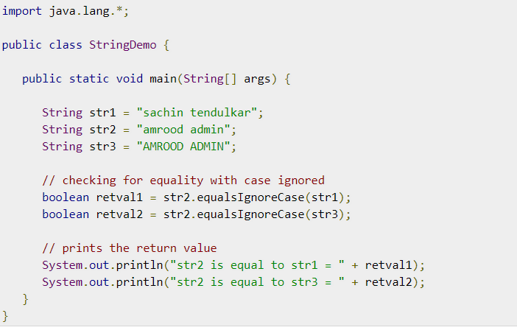


Slide 39
String Operations
compareTo() - Compares two strings lexicographically.
A string is less than another if it comes before the other in dictionary order. A string is greater than another if it comes after the other in dictionary order.
It compares strings on the basis of Unicode value of each character in the strings.
If first string is lexicographically greater than second string, it returns positive number (difference of character value).
If first string is less than second string lexicographically, it returns negative number and if first string is lexicographically equal to second string, it returns 0.
if s1 > s2, it returns positive number
if s1 < s2, it returns negative number
if s1 == s2, it returns 0

Slide 40
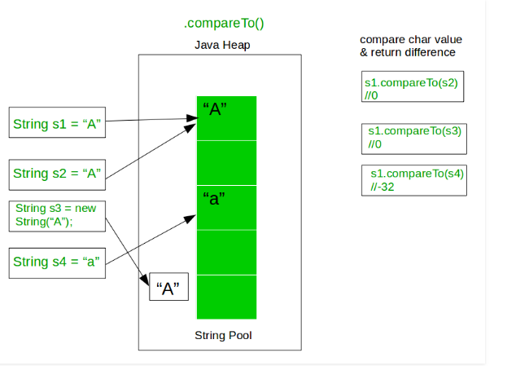

Slide 41
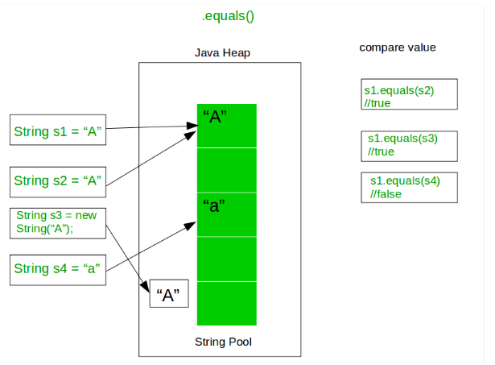

Slide 42
String Operations
program that sorts an array of strings import java.util.Arrays;
public class StringArrayInOrder {
public static void main(String args[]) {
String[] myArray = {"JavaFX", "HBase", "OpenCV", "Java", "Hadoop", "Neo4j"};
int size = myArray.length;
for(int i = 0; i<size-1; i++) {
for (int j = i+1; j<myArray.length; j++) {
if(myArray[i].compareTo(myArray[j])>0) {
String temp = myArray[i];
myArray[i] = myArray[j];
myArray[j] = temp;
} } }
System.out.println(Arrays.toString(myArray));
} }

Slide 43
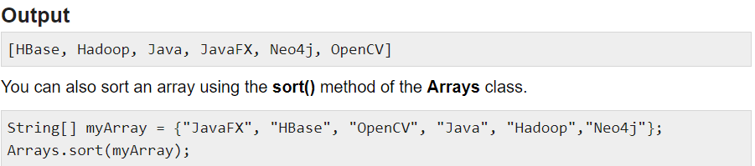
String Operations
Sample program that sorts an array of strings
If you want to ignore case differences when comparing two strings, use
compareToIgnoreCase( ), as shown here:
int compareToIgnoreCase(String str)

Slide 44
String Operations
The String class provides two methods that allow you to search a string for a specified character or substring:
indexOf( ) Searches for the first occurrence of a character or substring.
lastIndexOf( ) Searches for the last occurrence of a character or substring.
The methods return the index at which the character or substring was found, or –1 on failure.
public int indexOf(int ch)- Returns the index within this string of the first occurrence of the specified character.
public int indexOf(String str) - Returns the index within this string of the first occurrence of the specified substring.

Slide 45
String Operations
To search for the first or last occurrence of a substring, use
int indexOf(String str)
int lastIndexOf(String str)
Here, str specifies the substring.
You can specify a starting point for the search using these forms:
int indexOf(int ch, int startIndex)
int lastIndexOf(int ch, int startIndex)
int indexOf(String str, int startIndex)
int lastIndexOf(String str, int startIndex)

Slide 46
String Operations
public class IndexOfExample{
public static void main(String args[]) {
String str1 = new String("This is a BeginnersBook tutorial");
String str2 = new String("Beginners");
String str3 = new String("Book");
String str4 = new String("Books");
System.out.println("Index of B in str1: "+str1.indexOf('B'));
System.out.println("Index of B in str1 after 15th char:"+str1.indexOf('B', 15));
System.out.println("Index of B in str1 after 30th char:"+str1.indexOf('B', 30));
System.out.println("Index of string str2 in str1:"+str1.indexOf(str2));
System.out.println("Index of str2 after 15th char"+str1.indexOf(str2, 15));
System.out.println("Index of string str3:"+str1.indexOf(str3));
System.out.println("Index of string str4"+str1.indexOf(str4));
System.out.println("Index of hardcoded string:"+str1.indexOf("is"));
System.out.println("Index of hardcoded string after 4th char:"+str1.indexOf("is", 4));
}
}

Slide 47
String Operations
Index of B in str1: 10
Index of B in str1 after 15th char:19
Index of B in str1 after 30th char:-1
Index of string str2 in str1:10
Index of str2 after 15th char-1
Index of string str3:19
Index of string str4-1
Index of hardcoded string:2
Index of hardcoded string after 4th char:5

Slide 48
Modifying a String
Because String objects are immutable, whenever you want to modify a String, you must either copy it into a StringBuffer or StringBuilder, or use one of the following String methods,which will construct a new copy of the string with your modifications complete.
substring( )
You can extract a substring using substring( ).
It has two forms.
The first is
String substring(int startIndex)
Here, startIndex specifies the index at which the substring will begin.
This form returns a copy of the substring that begins at startIndex and runs to the end of the invoking string.
The second form of substring( ) allows you to specify both the beginning and ending index of the substring:
String substring(int startIndex, int endIndex)

Slide 49
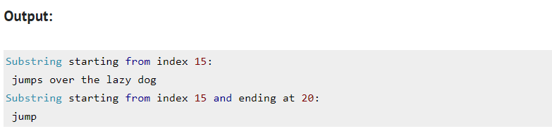
Modifying a String
public class SubStringExample{
public static void main(String args[]) {
String str= new String("quick brown fox jumps over the lazy dog");
System.out.println("Substring starting from index 15:");
System.out.println(str.substring(15));
System.out.println("Substring starting from index 15 and ending at 20:");
System.out.println(str.substring(15, 20));
}
}

Slide 50
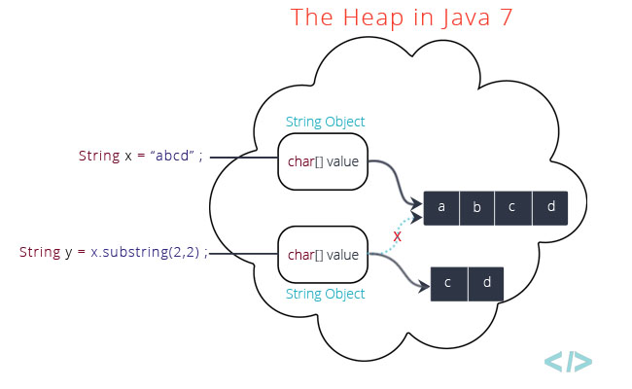
Modifying a String

Slide 51
Modifying a String
concat( )
You can concatenate two strings using concat( ), shown here:
String concat(String str)
This method creates a new object that contains the invoking string with the contents of str appended to the end.
concat( ) performs the same function as +. For example,
String s1 = "one";
String s2 = s1.concat("two");
puts the string “onetwo” into s2. It generates the same result as the following sequence:
String s1 = "one";
String s2 = s1 + "two";

Slide 52
Modifying a String
replace( )
The replace( ) method has two forms.
The first replaces all occurrences of one character in the invoking string with another character. It has the following general form:
String replace(char original, char replacement)
Here, original specifies the character to be replaced by the character specified by replacement.
The resulting string is returned.
For example,
String s = "Hello".replace('l', 'w');
puts the string “Hewwo” into s.
The second form of replace( ) replaces one character sequence with another. It has this general form:
String replace(CharSequence original, CharSequence replacement)

Slide 53
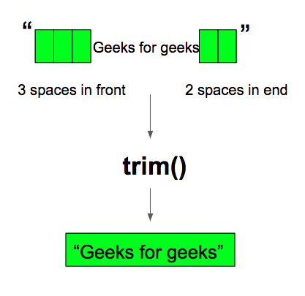
Modifying a String
trim( )
The trim( ) method returns a copy of the invoking string from which any leading and trailing whitespace has been removed.
The Unicode value of space character is ‘\u0020’. The trim() method in java checks this Unicode value before and after the string, if it exists then removes the spaces and returns the omitted string.
It has this general form:
String trim( )
Here is an example:
String s = " Hello World ".trim();
This puts the string “Hello World” into s.

Slide 54
Data Conversion Using valueOf( )
The valueOf( ) method converts data from its internal format into a human-readable form.
The java string valueOf() method converts different types of values into string.
By the help of string valueOf() method, you can convert int to string, long to string, boolean to string, character to string, float to string, double to string, object to string and char array to string.
public static String valueOf(boolean b)
public static String valueOf(char c)
public static String valueOf(char[] c)
public static String valueOf(int i)
public static String valueOf(long l)
public static String valueOf(float f)
public static String valueOf(double d)
public static String valueOf(Object o)

Slide 55
Data Conversion Using valueOf( )
int value=30;
String s1=String.valueOf(value);
System.out.println(s1+10);//concatenating string with 10
Output:3010
boolean bol = true;
String s1 = String.valueOf(bol);
System.out.println(s1);
Output:true

Slide 56
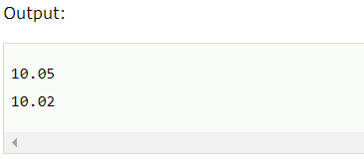

Data Conversion Using valueOf( )
float f = 10.05f;
double d = 10.02;
String s1 = String.valueOf(f);
String s2 = String.valueOf(d);
System.out.println(s1);
System.out.println(s2);
// char to String
char ch1 = 'A';
String s1 = String.valueOf(ch1);
System.out.println(s1);

Slide 57
Changing the Case of Characters Within a String
The method toLowerCase( ) converts all the characters in a string from uppercase to lowercase.
The toUpperCase( ) method converts all the characters in a string from lowercase to uppercase. Nonalphabetical characters, such as digits, are unaffected.
Here are the general forms of these methods:
String toLowerCase( )
String toUpperCase( )
Both methods return a String object that contains the uppercase or lowercase equivalent of the invoking String.
Here is an example that uses toLowerCase( ) and toUpperCase( ):

Slide 58

Changing the Case of Characters Within a String
// Demonstrate toUpperCase() and toLowerCase().
class ChangeCase {
public static void main(String args[])
{
String s = "This is a test.";
System.out.println("Original: " + s);
String upper = s.toUpperCase();
String lower = s.toLowerCase();
System.out.println("Uppercase: " + upper);
System.out.println("Lowercase: " + lower);
}
}

Slide 59
StringBuffer
StringBuffer is a peer class of String that provides much of the functionality of strings.
As you know, String represents fixed-length, immutable character sequences.
In contrast,StringBuffer represents growable and writeable character sequences.
StringBuffer may have characters and substrings inserted in the middle or appended to the end.
StringBuffer will automatically grow to make room for such additions and often has more characters preallocated than are actually needed, to allow room for growth.

Slide 60
StringBuffer
StringBuffer Constructors
StringBuffer defines these four constructors:
StringBuffer( )
StringBuffer(int size)
StringBuffer(String str)
StringBuffer(CharSequence chars)

Slide 61
StringBuffer
The default constructor (the one with no parameters) reserves room for 16 characters.
The second version accepts an integer argument that explicitly sets the size of the buffer.
The third version accepts a String argument that sets the initial contents of the StringBuffer object and reserves room for 16 more characters .
StringBuffer allocates room for 16 additional characters when no specific buffer length is requested, because reallocation is a costly process in terms of time.
Also, frequent reallocations can fragment memory.
By allocating room for a few extra characters, StringBuffer reduces the number of reallocations that take place.
The fourth constructor creates an object that contains the character sequence contained in chars.

Slide 62
StringBuffer
length( ) and capacity( )
The current length of a StringBuffer can be found via the length( ) method, while the total allocated capacity can be found through the capacity( ) method.
They have the following general forms:
int length( )
int capacity( )
Here is an example:
// StringBuffer length vs. capacity.
class StringBufferDemo {
public static void main(String args[]) {
StringBuffer sb = new StringBuffer("Hello");
System.out.println("buffer = " + sb);
System.out.println("length = " + sb.length());
System.out.println("capacity = " + sb.capacity());
}
}

Slide 63
StringBuffer
Here is the output of this program, which shows how StringBuffer reserves extra space for additional manipulations:
buffer = Hello
length = 5
capacity = 21
Since sb is initialized with the string “Hello” when it is created, its length is 5. Its capacity is 21 because room for 16 additional characters is automatically added.

Slide 64
StringBuffer
Here is the output of this program, which shows how StringBuffer reserves extra space for additional manipulations:
buffer = Hello
length = 5
capacity = 21
Since sb is initialized with the string “Hello” when it is created, its length is 5. Its capacity is 21 because room for 16 additional characters is automatically added.

Slide 65
StringBuffer
append( )
The append( ) method concatenates the string representation of any other type of data to the end of the invoking StringBuffer object. It has several overloaded versions.
StringBuffer append(String str)
StringBuffer append(int num)
StringBuffer append(Object obj)
String.valueOf( ) is called for each parameter to obtain its string representation.
The result is appended to the current StringBuffer object.
The buffer itself is returned by each version of append( ).
This allows subsequent calls to be chained together, as shown in the
following example:

Slide 66
StringBuffer
// Demonstrate append().
class Testmutablestring1{
public static void main(String args[]){
StringBuffer s=new StringBuffer("Sachin");
s.append(" Tendulkar");
System.out.println(s);
}
}The output of this example is shown here: Sachin Tendulkar

Slide 67
StringBuffer
insert( )
The insert( ) method inserts one string into another.
It is overloaded to accept values of all the simple types, plus Strings, Objects, and CharSequences.
Like append( ), it calls String.valueOf( ) to obtain the string representation of the value it is called with. This string is then inserted into the invoking StringBuffer object.
These are a few of its forms:
StringBuffer insert(int index, String str)
StringBuffer insert(int index, char ch)
StringBuffer insert(int index, Object obj)
Here, index specifies the index at which point the string will be inserted into the invoking
StringBuffer object.

Slide 68
StringBuffer
// Demonstrate insert().
class insertDemo {
public static void main(String args[]) {
StringBuffer sb = new StringBuffer("I Java!");
sb.insert(2, "like ");
System.out.println(sb);
}
}
The output of this example is shown here:
I like Java!

Slide 69
StringBuffer
reverse( )
You can reverse the characters within a StringBuffer object using reverse( ), shown here:
StringBuffer reverse( )
This method returns the reversed object on which it was called.
The following program demonstrates reverse( ):

Slide 70
StringBuffer
// Using reverse() to reverse a StringBuffer.
class ReverseDemo {
public static void main(String args[]) {
StringBuffer s = new StringBuffer("abcdef");
System.out.println(s);
s.reverse();
System.out.println(s);
}
}
Here is the output produced by the program:
abcdef
fedcba

Slide 71
StringBuffer
replace( )
You can replace one set of characters with another set inside a StringBuffer object by calling replace( ). Its signature is shown here:
StringBuffer replace(int startIndex, int endIndex, String str)
The substring being replaced is specified by the indexes startIndex and endIndex. Thus, the substring at startIndex through endIndex–1 is replaced.
The replacement string is passed in str.
The resulting StringBuffer object is returned.

Slide 72
StringBuffer
// Demonstrate replace()
class replaceDemo {
public static void main(String args[]) {
StringBuffer sb = new StringBuffer("This is a test.");
sb.replace(5, 7, "was");
System.out.println("After replace: " + sb);
}
}
Here is the output:
After replace: This was a test.

Slide 73
StringBuffer
substring( )
You can obtain a portion of a StringBuffer by calling substring( ). It has the following two forms:
String substring(int startIndex)
String substring(int startIndex, int endIndex)
The first form returns the substring that starts at startIndex and runs to the end of the invoking StringBuffer object.
The second form returns the substring that starts at startIndex and runs through endIndex–1.

Slide 74
Examples: StringBuffer
StringBuffer sb = new StringBuffer(“Hello”);
sb.length(); // 5
sb.capacity(); // 21 (16 characters room is added if no size is specified)
sb.charAt(1); // e
sb.setCharAt(1,’i’); // Hillo
sb.setLength(2); // Hi
sb.append(“l”).append(“l”); // Hill
sb.insert(0, “Big “); // Big Hill
sb.replace(3, 11, “”); // Big
sb.reverse(); // giB

Slide 75
StringBuffer
ensureCapacity( )
If you want to preallocate room for a certain number of characters after a StringBuffer has been constructed, you can use ensureCapacity( ) to set the size of the buffer.
This is useful if you know in advance that you will be appending a large number of small strings to a StringBuffer.
ensureCapacity( ) has this general form:
void ensureCapacity(int capacity)
Here, capacity specifies the size of the buffer.

Slide 76
StringBuffer
setLength( )
To set the length of the buffer within a StringBuffer object, use setLength( ). Its general form is shown here:
void setLength(int len)
Here, len specifies the length of the buffer. This value must be nonnegative.
When you increase the size of the buffer, null characters are added to the end of the existing buffer.
If you call setLength( ) with a value less than the current value returned by length( ), then the characters stored beyond the new length will be lost.

Slide 77
StringBuffer
charAt( ) and setCharAt( )
The value of a single character can be obtained from a StringBuffer via the charAt( ) method.
You can set the value of a character within a StringBuffer using setCharAt( ). Their general forms are shown here:
char charAt(int where)
void setCharAt(int where, char ch)
For charAt( ), where specifies the index of the character being obtained.
For setCharAt( ), where specifies the index of the character being set, and ch specifies the new value of that character.
For both methods, where must be nonnegative and must not specify a location
beyond the end of the buffer.

Slide 78
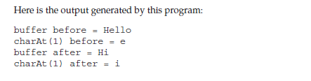
StringBuffer
// Demonstrate charAt() and setCharAt().
class setCharAtDemo {
public static void main(String args[]) {
StringBuffer sb = new StringBuffer("Hello");
System.out.println("buffer before = " + sb);
System.out.println("charAt(1) before = " + sb.charAt(1));
sb.setCharAt(1, 'i');
sb.setLength(2);
System.out.println("buffer after = " + sb);
System.out.println("charAt(1) after = " + sb.charAt(1));
}
}

Slide 79
StringBuffer
getChars( )
To copy a substring of a StringBuffer into an array, use the getChars( ) method. It has this
general form:
void getChars(int sourceStart, int sourceEnd, char target[ ],int targetStart)
Here, sourceStart specifies the index of the beginning of the substring, and sourceEnd specifies an index that is one past the end of the desired substring.
This means that the substring contains the characters from sourceStart through sourceEnd–1.
The array that will receive the characters is specified by target. The index within target at which the substring will be copied is passed in targetStart.
Care must be taken to assure that the target array is large enough to hold the number of characters in the specified substring.

Slide 80
StringBuffer
delete( ) and deleteCharAt( )
You can delete characters within a StringBuffer by using the methods delete( ) and
deleteCharAt( ).
StringBuffer delete(int startIndex, int endIndex)
StringBuffer deleteCharAt(int loc)
The delete( ) method deletes a sequence of characters from the invoking object.
Here,startIndex specifies the index of the first character to remove, and endIndex specifies an index one past the last character to remove.
Thus, the substring deleted runs from startIndex to endIndex–1. The resulting StringBuffer object is returned.
The deleteCharAt( ) method deletes the character at the index specified by loc. It returns the resulting StringBuffer object.

Slide 81
StringBuffer
// Demonstrate delete() and deleteCharAt()
class deleteDemo {
public static void main(String args[]) {
StringBuffer sb = new StringBuffer("This is a test.");
sb.delete(4, 7);
System.out.println("After delete: " + sb);
sb.deleteCharAt(0);
System.out.println("After deleteCharAt: " + sb);
}
}
The following output is produced:
After delete: This a test.
After deleteCharAt: his a test.

Slide 82
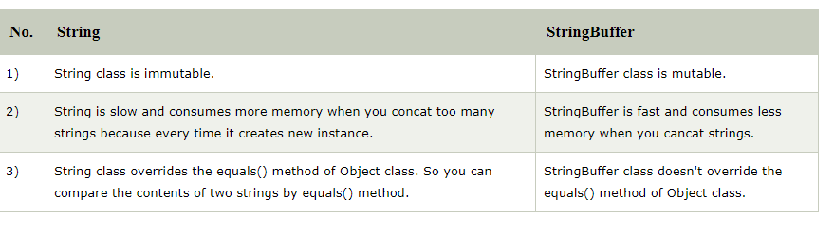
String vs StringBuffer

Slide 83
CONCLUSION
String is one of the most widely used class in java programming
String class represents character string
String is immutable in Java
Since String is immutable in Java, whenever we do String manipulation like concatenation, substring etc, it generates a new String and discards the older String for garbage collection.
Java has provided StringBuffer class that can be used for String manipulation.
StringBuffer is mutable classes.

